Slide 1
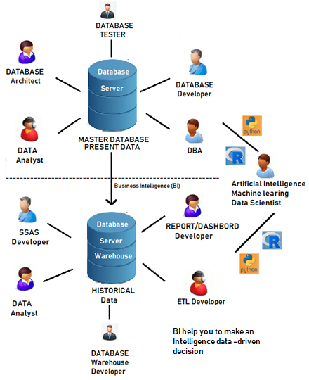

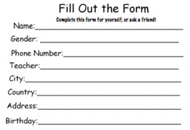
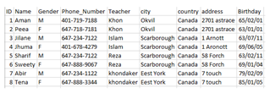
Background of Database
1-1
What is Data ?
Front-end developer and Back-end developer
Data is a collection of facts. Example: consider yourself, Name, Age, Height, Weight address all would be data related to you, Even Picture, Image, File all consider is Data. We are creating millions of, billions of data every day, updating Facebook status or purchasing items from stores or withdrawing money from ATM machine, people are generating data in every second.
Front-end web or application developer use number of languages such as C#, VB.NET, C++ and F#, Java, Python, PHP,CSS to develop the application. Front end language is changed often. On the other hand, back- end developer also develop database using Query language SQL (such as Oracle, SQL server, DB2, MySQL so on) using RDBMS. Backend database are very similar to each other and does not changed very often.
What is Database?
Database is a systematic collection of data from the Random information. A Database Management System allows a person to organize, store, and retrieve data from a computer. It is a way of communicating with a computer’s “stored memory.”
What is database Management System(DBMS)
A database Management System allow a person to organize,
Store, and retrieve data from a computer. It is a way of communicating
with a computer’s Data storage.
Browser
Data Storage
Front-End (application)
Back-End (Database Server)
ODBC
Server=sql_box;
Database=Common;
User ID=uid;
Pwd=password

Slide 2
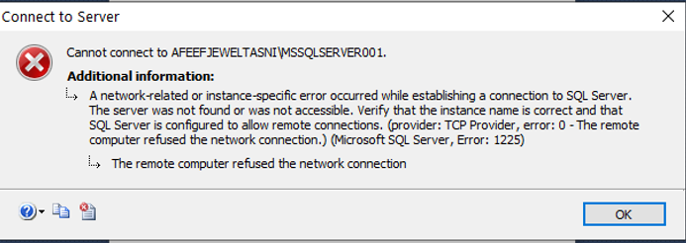
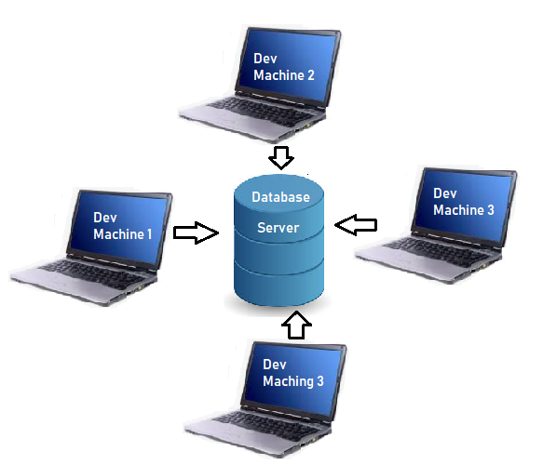

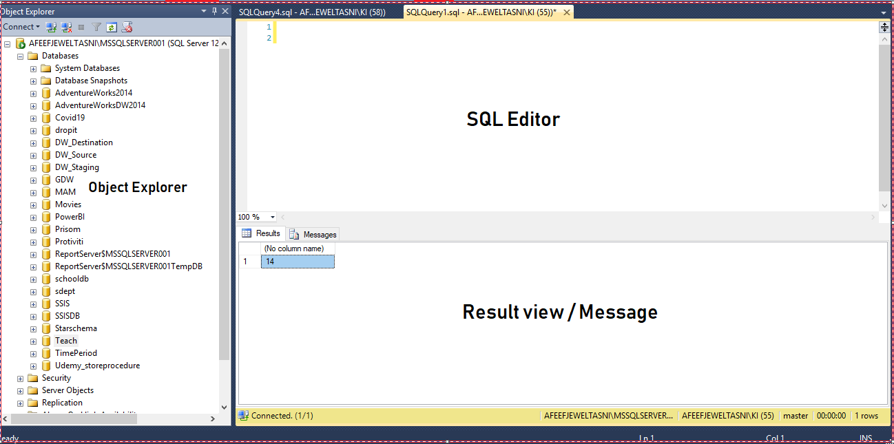
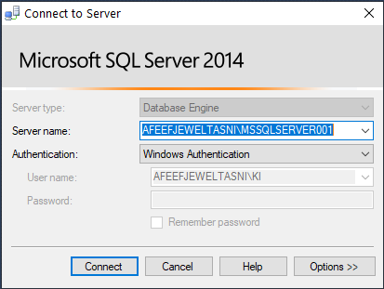
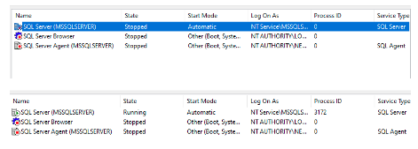
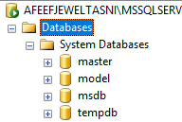
Install SQL Server and Familiar
1-2
Install SQL Server 2014
Familiar with the SQL Server (SQL Server management Studio)
When Fail to connect SQL Server.
Four developers are connected to SQL server database through SSMS. The database can be reside on-premises or in cloud environment.
Server Type: Database Engine,
Server Name: (local) or . or 127.0.0.1
Authentication: Windows Authentication or SQL Server Authentication:
DBMS
Menu bar
Toolbar
DBMS
DBMS
DBMS
Right Click Start (Window) > Click Computer Management> Open or extended Service and Application > Open or extended SQL Server Configuration Manager. > Click SQL Server Services
IF SQL Server State(MSSQLSERVER) is showing Stopped, Highlight the SQL Server (MSSQLSERVER) , right click and click start. State should show Running.
DBMS
So SSMS is not the server, it is a Client tool. Developer connects to SQL Server using SSMS Client tool.
Connecting to SQL server with SSMS
Master – Information about all the database going to be in this server, SQL server configuration, login information.
Model – is a template database, when new database is create, the contents of the Model database are copies to the new database. Like table, view so on.
Msdb – MSdb stores all sort of data , such as backup, restore history, tuning advisor data, SQL agent job history so on.
Tempdb – Tempdb is a system database. SQL server used as a store temporary tables, Index

Slide 3

Database, Table, Insert, Schema, Fetch Data
1-3
Create database, Where does SQL Server database reside?
Create table graphically and using code, Understanding Schema,
constraints
Insert data into a tables, and what are others processes of Insert data
Fetch data from single tables
Fetch data from emp table every possible way. (code is not case sensitive)
SQL Syntax is: SELECT <column_name> FROM <table_name> WHERE <condition>
---Fetch all the data from the employees table.
---Fetch Last_name, job_ID and salary from employees
---Fetch first two rows from the employees table
---Fetch King's all information.
---Assign alias for Employee_ID, Last_Name and salary columns, show different patterns.
---Fetch Chen, Austin and king’s employee_id, last_name and salary from employees table
---Fetch all the information between 100 to 105 from employees table
---Fetch all the information using like operator(%) from employees table[different ways]
---Fetch employee salary more than 16000 dollars
---Fetch employee salary Less than 13000 dollars
---Fetch employee’s data where employee’s salary more than 8000 and less than 13000
---Fetch employee’s from the table when salary will not show 8000
---fetch hire date using alias from employees table
---Fetch Unique Job id from employees table
---Fetch data from employees, show the difference using ‘and’ / ‘or ’ operators
---Fetch employee_id and salary ascending and Descending order.
---Fetch last two row from the table
---Fetch data who get the commission and who did not get commission.
Create database <database name>
Create database graphically and using a Query
-------Drop database < database name>
Right click database, give the database name, OK
-------Drop database < database name>
Database create two files
data files (.MDF file)
and transaction log file( .LDF file)
Where you can see data files??
C:\Program Files\Microsoft SQL Server\MSSQL12.MSSQLSERVER\MSSQL\DATA
Create a table in a database
USE <database>
GO
What is Schema?
Working with unknown value.
SQL Server uses NULL to make missing values. A Null is neither TRUE or FALSE but it is make for UNKNOWN. NULL values as part of table is not good. Avoid storing NULL value, instead replace with DEFAULT value.
Schema is mainly used to Manage several logical entities in one physical database.
Schemas offer a convenient way to separate database users from database object owners.(dbo) (divided into database tables in the case of relational databases). –go to AdventureWork 2014 -- ---Example (HR, Person, Production, Purchase, Sale so on)
Schema of the table write sp_help <table Name>
Logical Order
Insert data graphically and using a query.

Slide 4
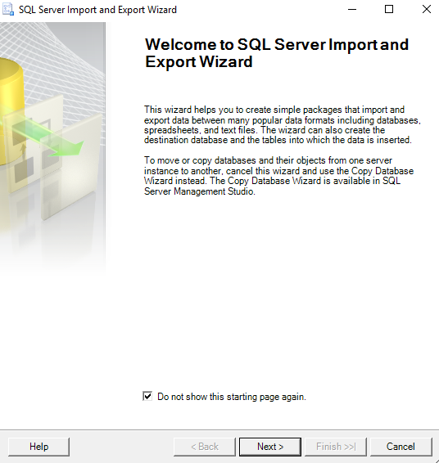
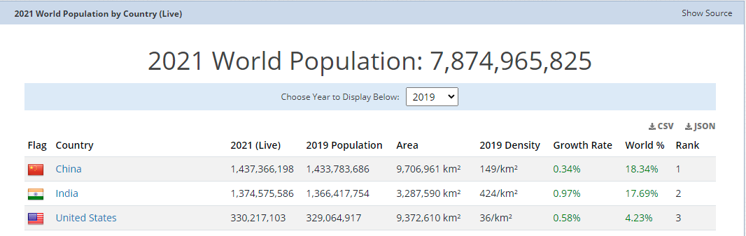
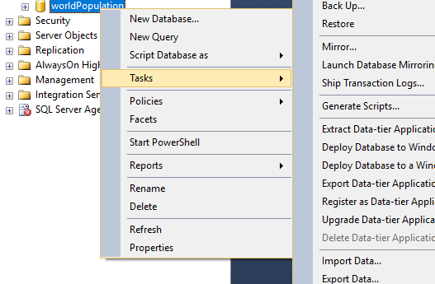
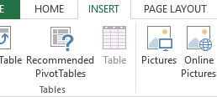
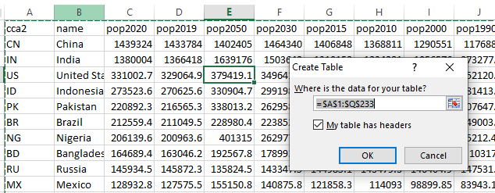
Data Export Import
1-4
Go to following Url
https://worldpopulationreview.com/
Go next > Choose Data Source (Microsoft excel) > Browse Excel File path (wp.xls) > next > Choose Destination ( SQL Server NativeClient 11.0 > Database WorldPopulation > Next > click excel Sheet
> Next > Run immediately , Next > Finished
Scroll down and click csv as shown bellow
Download
Place your cursor inside the table any place > Click insert > click table
> Click OK
Save the files on your desktop
as a WP.xls
Create a database worldPopulation > right Click wp database >
Tasks > click import Data

Slide 5
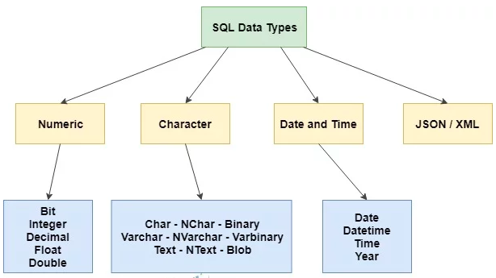
SQL Data Types
1-5
SQL developer must decide what type of data that will be stored inside each column when creating a table.
Numbers of characters use
In data type.
Char to char(8000)
Varchar to varchar(8000)
Varchar(max)
nvarchar to nvarchar(4000)
Create small tamp
table, show datatype
Numeric Data
Tinyint(1 byte) – 0 to 255
Smallint (2 bytes) –32,768 to 32767
Int ( 4 bytes)
Bigint (8 bytes)
Decimal or Number (8 Bytes)
Waste space
Unicode and Non Unicode
Unicode ---Universal supported data, when data use Globally ( All culture “N” National language) --- 2 byte = 1 character
Non-Unicode --- Non Universal supported data, When data use locally ( only English culture non National Language) -- 1 byte = 1 character
(( 1 bit means 0 or 1, 8 bit make one byte. 0 ,1 = 2⁸ = 256 character can be use like 1,2, @, <, >, [, (, so on . gigabyte is eight times bigger than one gigabit.))

